Slide 1
PLT User Interface Proposal
Matt Hollingsworth

Slide 2
Python-Based Web GUI
Core functionality
All functionality of startup scripts (Pulls DACs from DB)
Run calibrations
Start data runs
Tie all of the above together in the DB
Utilizes plt python library for doing the work
Wrapper over existing C++ code
All functionality can have a corresponding command line utility as well
Runs calibrations as a collection in a given sequence
Run, validate, run, validate…
State machine integrated
Global run in “Configuring” state shows configuration panel, in “Calibrating” state shows calibration panel etc.
One global run allowed at a time (all others in DB must be in “stopped” state)
Later features
Dynamic feedback/DQM for calibrations
Monitoring of data runs
Plots
Etc.

Slide 3
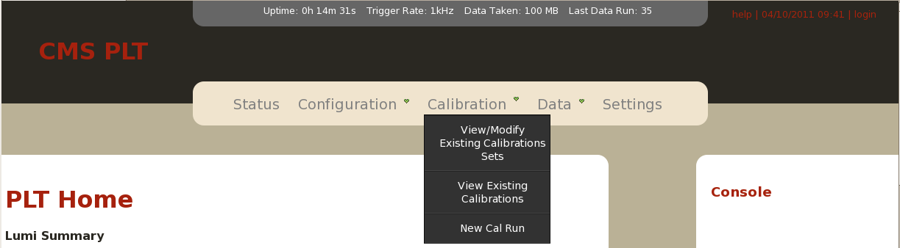
Much of the core functionality exists already but hasn’t been tested
Need working test stand with someone around to power cycle and a way to get scope traces for development

Slide 4
Database
Use ORM so that db backend is flexible (starts off with sqlite3, can switch to oracle or MySQL later)
DB can be populated from files (each import is associated with a configuration ID)
Calibration runs are collected together into a CalibrationSet
CalibrationSets are associated with data runs
Raw calibration results saved into root files
Root files versioned with Anthony’s framework
High level results (fit coefficients, etc) saved directly into DB

Slide 5
XDAQ Proxy
If deemed necessary, we can develop an xdaq proxy to the system
Communicates with the primary system via SOAP messages
Contains basic state machine, leaving the main work to the core server process

Slide 6
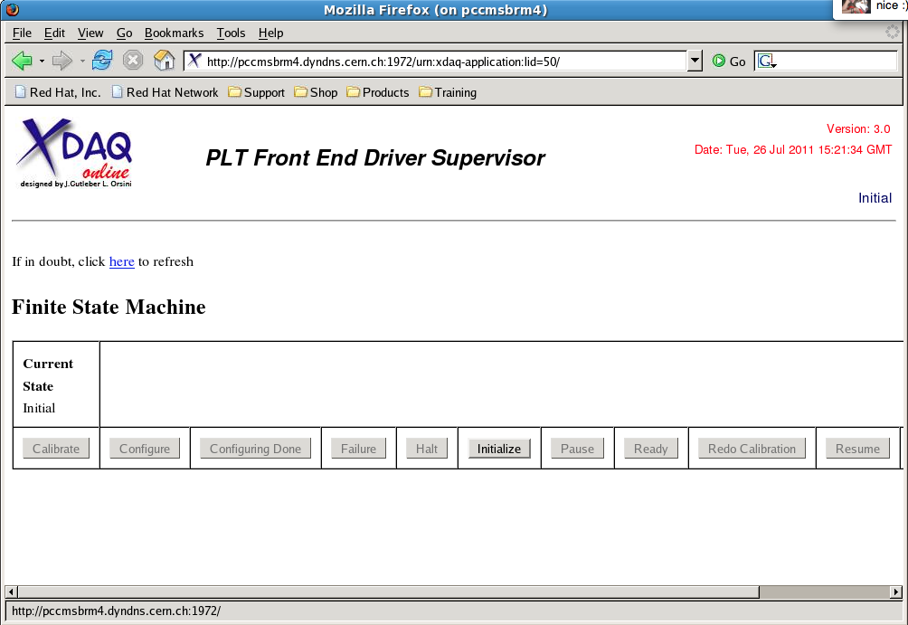
XDAQ Proxy

